Slide 1
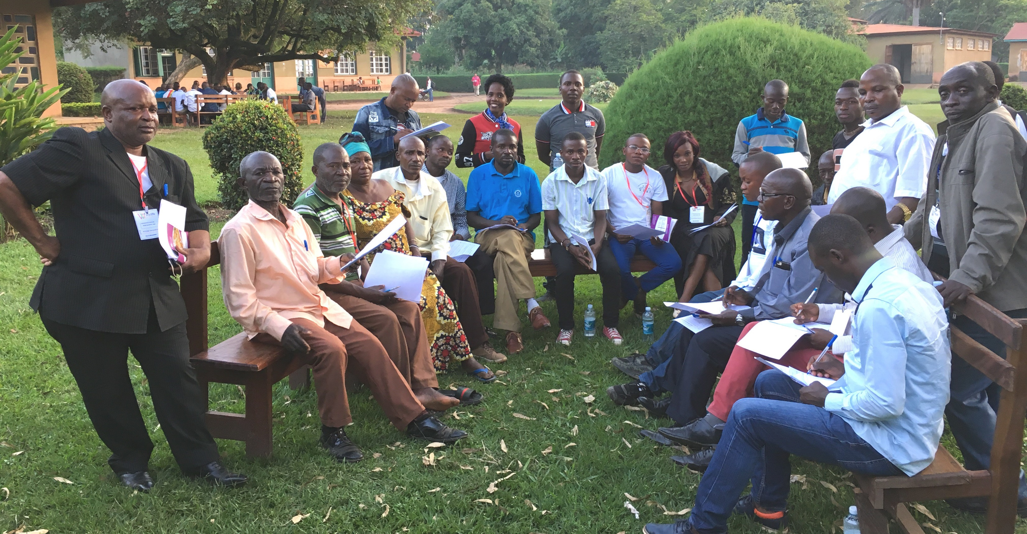
Church-Owned Bible Translation
6 Behaviors of the Local Church

Slide 2
?
What kinds of behaviors do we see in a language community that believes in COBT?

Slide 3
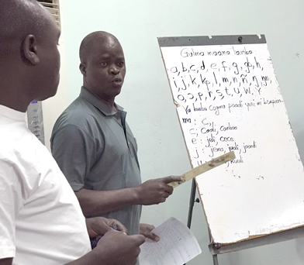

1. Translates Bible into heart language
Responsible
Local Church
In Heart Language

Slide 4
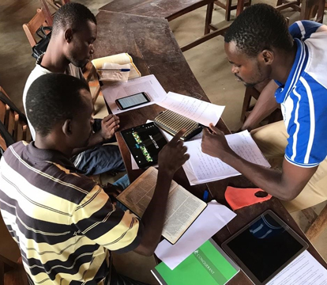

2. Manages accessibility to the Bible
Accessibility
Local Church

Slide 5

3. Refines and revises the translation
Checking
Refine
Translate
Revise
Church Team

Slide 6
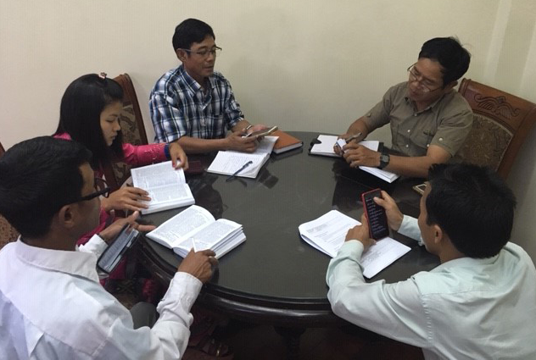
4. Engages community in Scripture usage

Slide 7
5. Shares COBT with others

Slide 8
6. Owns generational revisions and updates
Us
Our children
Our grandchildren

Slide 9


